Slide 1

Python Data Structures for Java Programmers
Bill Nicholson
nicholdw@ucmail.uc.edu
CCSC:MW Fall 2021

Slide 2
Abstract
This tutorial introduces Python data structures such as Lists, Sets, Tuples, Strings, and Dictionaries. It draws connections to data structures in Java. Attendees will learn how Python data structures differ from and overlap with similar data structures in Java.

Slide 3


Bill Nicholson
Associate Professor Educator
University of Cincinnati Clermont College
Java programmer, Python learner
Information Technology Program
nicholdw@ucmail.uc.edu
IU Fan.

Slide 4
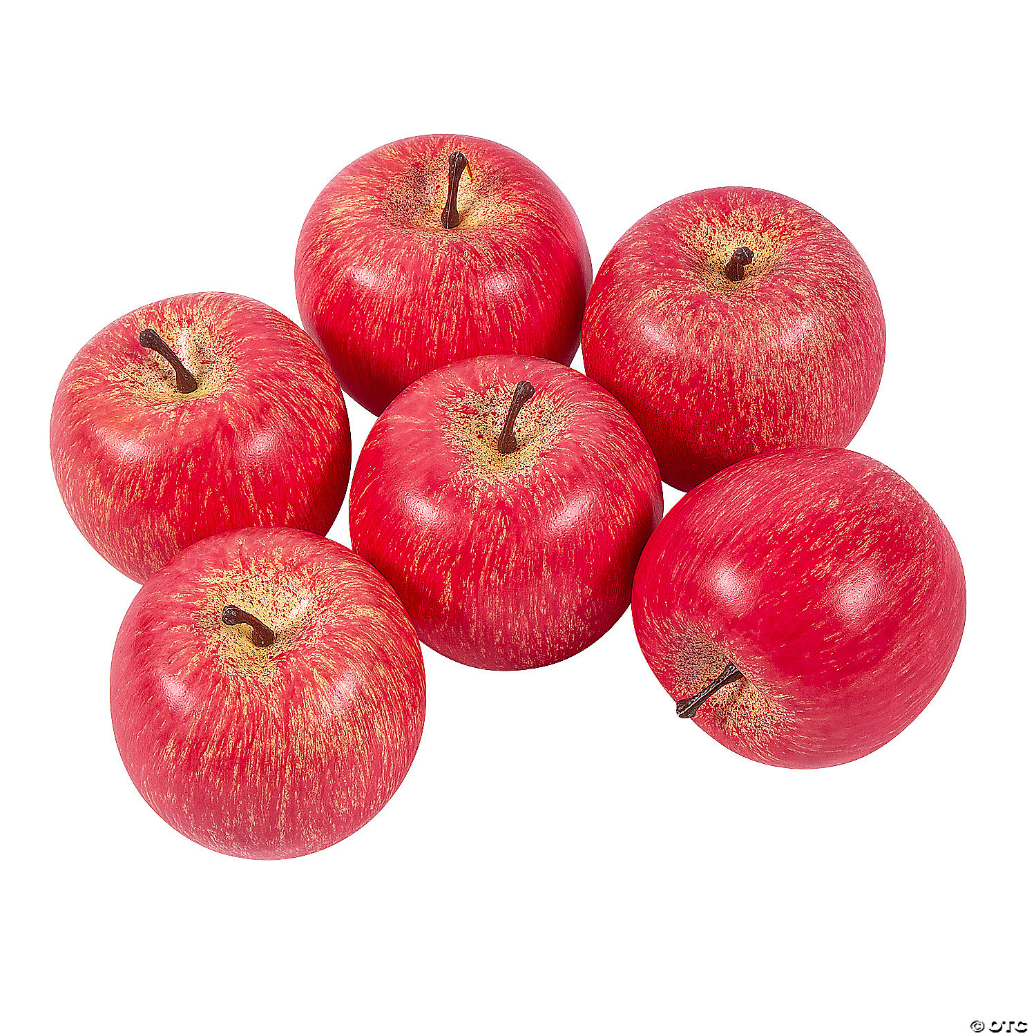
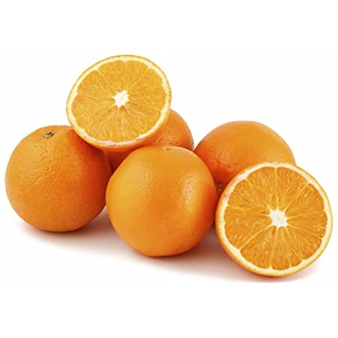
Not Addressed in this presentation
Synchronization/Thread Safe issues
Internal representation
Data structures in ‘3rd Party’ libraries
Numpy and Pandas
*Performance
Differences between Python versions
!=
I couldn’t resist. There is a little benchmarking at the end of the presentation.

Slide 5
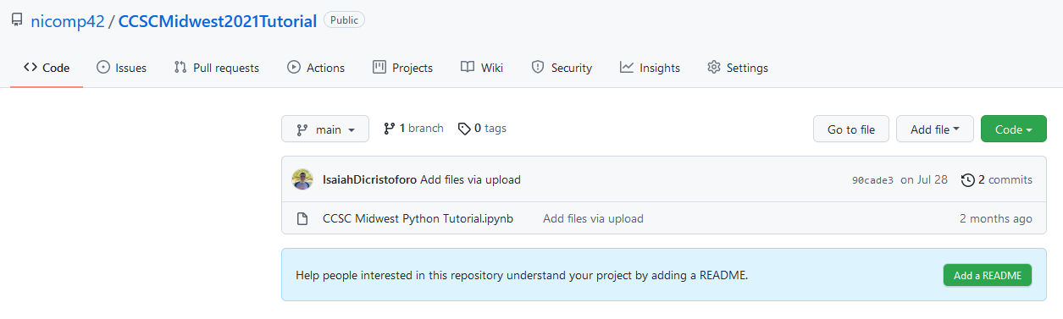
Presentation Materials
https://github.com/nicomp42/CCSCMidwest2021Tutorial

Slide 6
Overview
 | Released | Compiled? | Typing | OOP?
Java | 1995 | To bytecode | Static | Yes
Python | 1991 | Interpreted | Dynamic | Hybrid

Slide 7




Our Tools (all free)
Reasonably current versions of
Python interpreter (python.org)
Jupyter Notebook (anaconda.com)
Java
Eclipse
[1,2,3,4]

Slide 8
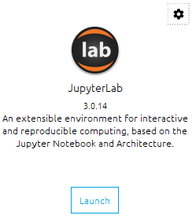
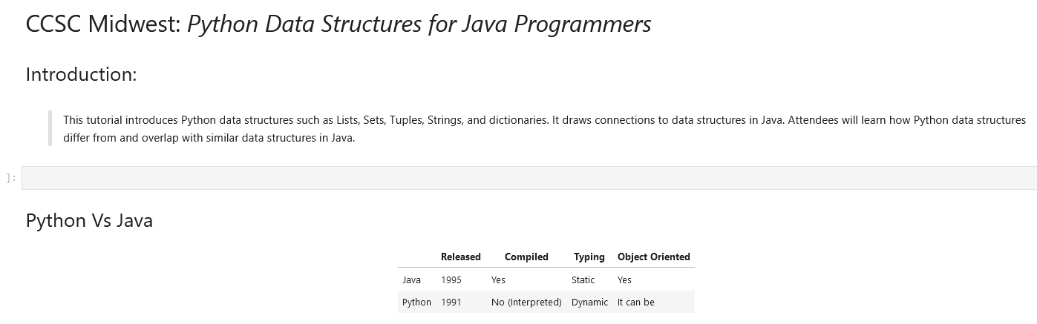
JupyterLab Notebook
.ipynb file.
Cell oriented IDE.
Code and markdown cells.
Executing a cell affects the current execution environment.
Cells can be executed individually, even out of order!
In our notebook, each cell is stand-alone.

Slide 9
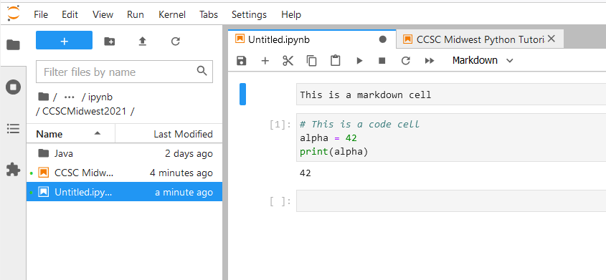
A JupyterLab Notebook Runs in a Web Browser Tab
Effective for teaching basic concepts because it’s cell-oriented and supports markdown
Not effective for enterprise work, IMHO.

Slide 10
Python: ‘built-in’ types to be discussed
List
Tuple
Set
Dictionary
String

Slide 11
Java to Python mapping
Java | Python Nomenclature | Python Class (case sensitive)
ArrayList | List | list
array | Tuple | tuple
HashSet | Set | set
HashMap | Dictionary | dict
String | String | str

Slide 12
Python Data Structures Overview
Data Structure | Ordered | Can be Heterogeneous | Indexable | Syntax | Example | Duplicate Elements | Mutable | Notes
List | Yes | Yes | Yes | [ ] | a = [1,2,3,4,5] | Yes | Yes
Tuple | Yes | Yes | Yes | ( ) | a = (1,2,3,4,5) | Yes | No | Similar to List but immutable
Set | No | Yes | No | { } | a = {1,2,3,4,5} | No (dups ignored) | Yes
Dictionary (It’s a set) | Sort-of* | Yes | By Key | { } : | a = {“a”:23, ”b”:45} | No (dup key overwrites existing key) | Yes | Key/Value pairs
String | N/A | N/A | Yes | “ “ | a = “12345” | N/A | No | Single or double quotes OK. There is no char type.
* “Insertion Order”
https://stackoverflow.com/questions/39980323/are-dictionaries-ordered-in-python-3-6

Slide 13
Syntax determines data type
myList = [1,2,3,4,5] # List
myTuple = (1,2,3,4,5) # Tuple
mySet = {1,2,3,4,5} # Set
myDictionary = {“key1”:1, “key2”:2, “key3”:3} # Dictionary
myString = “12345” # String

Slide 14
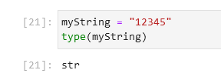
Python is dynamically typed, so… when in doubt
Rely on the type function
myString = "12345"
type(myString)

Slide 15
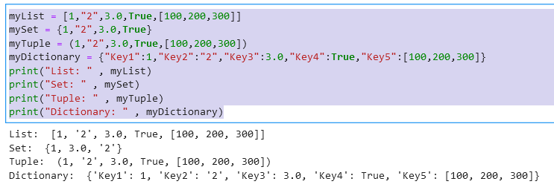
Heterogeneity
myList = [1,"2",3.0,True,[100,200,300]]
mySet = {1,"2",3.0,True}
myTuple = (1,"2",3.0,True,[100,200,300])
myDictionary = {"Key1":1,"Key2":"2","Key3":3.0,"Key4":True,"Key5":[100,200,300]}
print("List: " , myList)
print("Set: " , mySet)
print("Tuple: " , myTuple)
print("Dictionary: " , myDictionary)
Notes:
Data Structures by Characteristic.ipynb

Slide 16
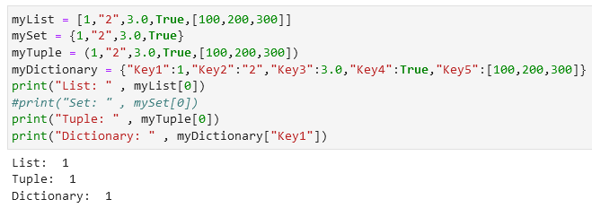
Indexing
myList = [1,"2",3.0,True,[100,200,300]]
mySet = {1,"2",3.0,True}
myTuple = (1,"2",3.0,True,[100,200,300])
myDictionary = {"Key1":1,"Key2":"2","Key3":3.0,"Key4":True,"Key5":[100,200,300]}
print("List: " , myList[0])
#print("Set: " , mySet[0])
print("Tuple: " , myTuple[0])
print("Dictionary: " , myDictionary["Key1"])
Notes:
Data Structures by Characteristic.ipynb

Slide 17
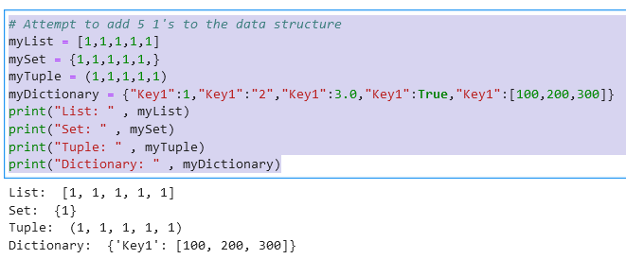
Duplicate Elements
# Attempt to add 5 1's to the data structure
myList = [1,1,1,1,1]
mySet = {1,1,1,1,1,}
myTuple = (1,1,1,1,1)
myDictionary = {"Key1":1,"Key1":"2","Key1":3.0,"Key1":True,"Key1":[100,200,300]}
print("List: " , myList)
print("Set: " , mySet)
print("Tuple: " , myTuple)
print("Dictionary: " , myDictionary)
Notes:
Data Structures by Characteristic.ipynb

Slide 18
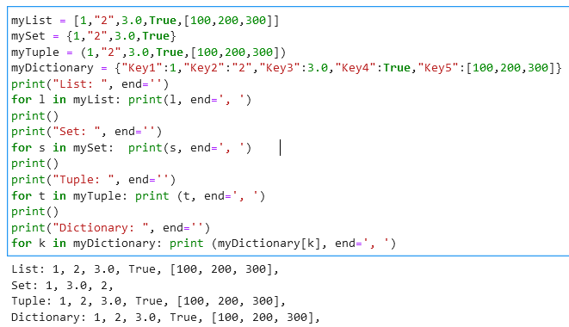
Iterating
myList = [1,"2",3.0,True,[100,200,300]]
mySet = {1,"2",3.0,True}
myTuple = (1,"2",3.0,True,[100,200,300])
myDictionary = {"Key1":1,"Key2":"2","Key3":3.0,"Key4":True,"Key5":[100,200,300]}
print("List: ", end='')
for l in myList: print(l, end=', ')
print()
print("Set: ", end='')
for s in mySet: print(s, end=', ')
print()
print("Tuple: ", end='')
for t in myTuple: print (t, end=', ')
print()
print("Dictionary: ", end='')
for k in myDictionary: print (myDictionary[k], end=', ')
Notes:
Data Structures by Characteristic.ipynb

Slide 19
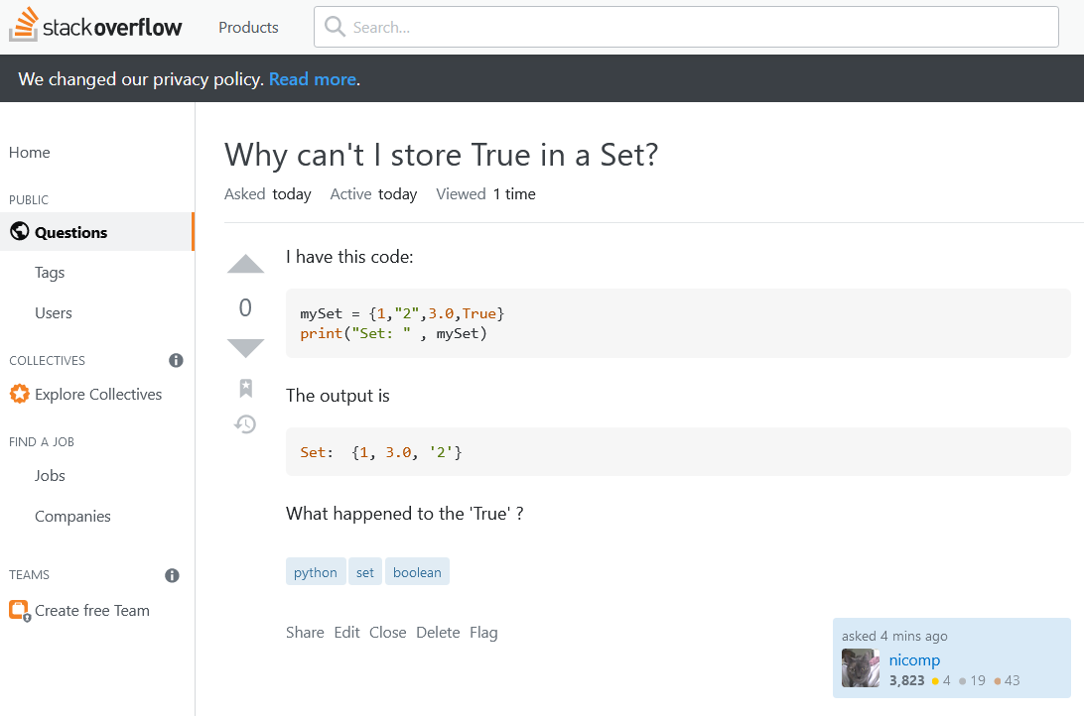
While preparing this presentation
mySet = {1,"2",3.0,True}
print("Set: " , mySet)
https://stackoverflow.com/questions/69407136/why-cant-i-store-true-in-a-set

Slide 20

Python List Java ArrayList
Feature | Python List | Java ArrayList
mutable | Yes | Yes
heterogeneous | Yes | Yes, if you go unsafe
delimiter | [ ] | [ ] , kind-of
can contain duplicates | Yes | Yes
can insert | Yes | Yes
can append | Yes | Yes
indexable | Yes, with [ ] | Yes, with method call
ordered | Yes | Yes
List of Lists | Yes | Yes
‘Slice’ syntax | Yes | No
‘Built-in’ | Yes | No (java.util.ArrayList)

Slide 21
List Highlights
Create | myList = [1, ”2”, 3.0, True]
Add an element to the end | myList.append(“new”)
Remove last element | myList.pop()
Insert an element at an index | myList.insert(0, 999)
Search for an element | if 1 in myList: print (“Element found")
Get index of an element | idx = myList.index(999)
Check length | len(myList)
Iterate | for element in myList: print(element)
Remove all elements | myList.clear()

Slide 22
Python Tuple Java Array
Feature | Python Tuple | Java Array
mutable | No | Yes
heterogeneous | Yes | Yes (Array of Object types)
delimiter | ( )
can contain duplicates | Yes | Yes
can insert | No | No
can append | No | No
indexable | Yes | Yes
ordered | Yes | Yes
Tuple of Tuples | Yes | Yes
‘Slice’ syntax | Yes | No
‘Built-in’ | Yes | Yes

Slide 23
Tuple Highlights
Create | myTuple = (1,2,3,4,5)
Add/Replace an element | Can’t
Remove an element | Can’t
Remove all elements | myTuple = () # Actually a new Tuple
Search for an element | if 2 in myTuple: print (“Element found")
Check length | len(myTuple)
Iterate | for element in myTuple: print(element)

Slide 24
Python Set Java HashSet
Feature | Python Set | Java HashSet
mutable | Yes* | Yes
heterogeneous | Yes | Yes, if you go unsafe
delimiter | { } | N/A
can contain duplicates | No | No
can insert | N/A (not ordered) | N/A
can append | N/A | N/A
indexable | No | No
ordered | No | No
Set of Sets | Yes | Yes
‘Slice’ syntax | No | No
‘Built-in’ | Yes | No (java.util.HashSet)
*Once a set is created, items cannot be edited except to remove them, but new items can be added.

Slide 25
Set Highlights
Create | mySet = {1,2,3,4}
Add an element | mySet.add(5)
Remove an element | mySet.discard(5)
Remove all elements | mySet.clear()
Search for an element | if 4 in mySet: print(“found”)
Check length | len(mySet)
Iterate | for element in mySet: print(element)

Slide 26
Python Dictionary Java HashMap
Feature | Python Dictionary | Java HashMap
mutable | Yes | Yes
heterogeneous | Yes | Yes (Unsafe warning)
delimiter | { } :
can contain duplicates | Keys, no | Keys, no
can insert | Yes | Yes
can append | N/A | N/A
indexable | No | No
ordered | No (insertion order does not follow iterable order) | No (insertion order does not follow iterable order)
Dictionary of Dictionaries | Yes
‘Slice’ syntax | No | No
Key/Value pairs | Yes | Yes
‘Built-in’ | Yes | No (java.util.HashMap)

Slide 27
Dictionary Highlights
Create | myDictionary = {"key1":1, "key2":2, "key3":3}
Add/Replace an element | myDictionary["key4"] = 4
Remove an element | myDictionary.pop("key1")
Search for an element | if "key2" in myDictionary: print ("Key found")
Check length | len(myDictionary)
Iterate | for key in myDictionary: print (key + ": " + str(myDictionary[key]))
Remove all elements | myDictionary.clear()

Slide 28
Python String Java String
Feature | Python String | Java String
mutable | No | No
heterogeneous | N/A | N/A
delimiter | Single quotes or double quotes | Double quotes
can contain duplicates | N/A | N/A
can insert | No | No
can append | No | No
indexable | Yes, use [ ] | Yes, use charAt method
ordered | Yes | Yes
String of Strings | N/A | N/A
‘Slice’ syntax | Yes | No
‘Built-in’ | Yes | Yes

Slide 29
String Highlights
Create | myString = "Hello World"
Add/Replace an element | N/A
Search for a substring | if "Hello" in myString: print ("Substring found")
Check length | len(myString)
Iterate | for c in myString: print(c)

Slide 30
Let’s be Pythonic List Comprehension - the big picture
new_list = [expression for member in list if condition]

Slide 31
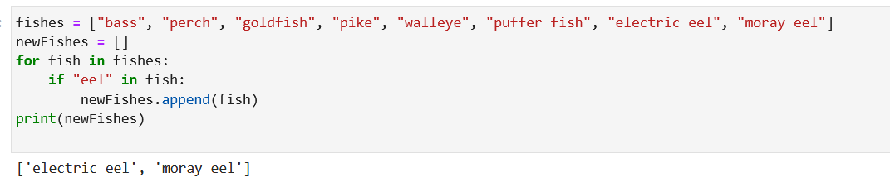
List can be processed with loops
fishes = ["bass", "perch", "goldfish", "pike", "walleye", "puffer fish", "electric eel", "moray eel"]
newFishes = [ ]
for fish in fishes:
if "eel" in fish:
newFishes.append(fish)
print(newFishes)

Slide 32
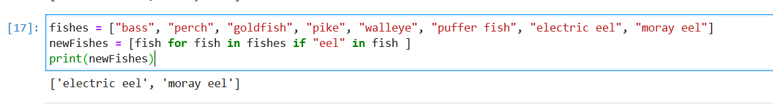
List Comprehension is pythonic
fishes = ["bass", "perch", "goldfish", "pike", "walleye", "puffer fish", "electric eel", "moray eel"]
newFishes = [fish for fish in fishes if "eel" in fish ]
print(newFishes)

Slide 33
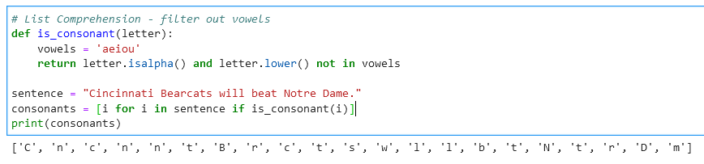
List Comprehension – Filter out vowels
# List Comprehension - filter out vowels
def is_consonant(letter):
vowels = 'aeiou'
return letter.isalpha() and letter.lower() not in vowels
sentence = "Cincinnati Bearcats will beat Notre Dame."
consonants = [i for i in sentence if is_consonant(i)]
print(consonants)

Slide 34
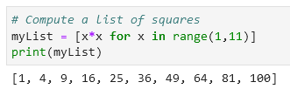
List Comprehension – Compute a list of squares
# Compute a list of squares
myList = [x*x for x in range(1,11)]
print(myList)

Slide 35
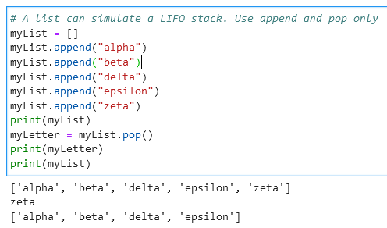
A list can simulate a LIFO stack. Use append() and pop() only
myList = []
myList.append("alpha")
myList.append("beta")
myList.append("delta")
myList.append("epsilon")
myList.append("zeta")
print(myList)
myLetter = myList.pop()
print(myLetter)
print(myList)

Slide 36
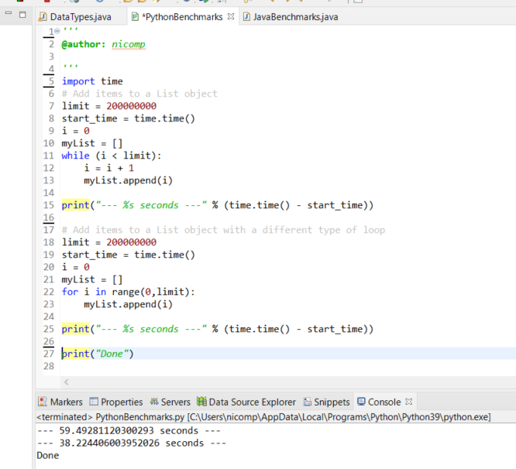
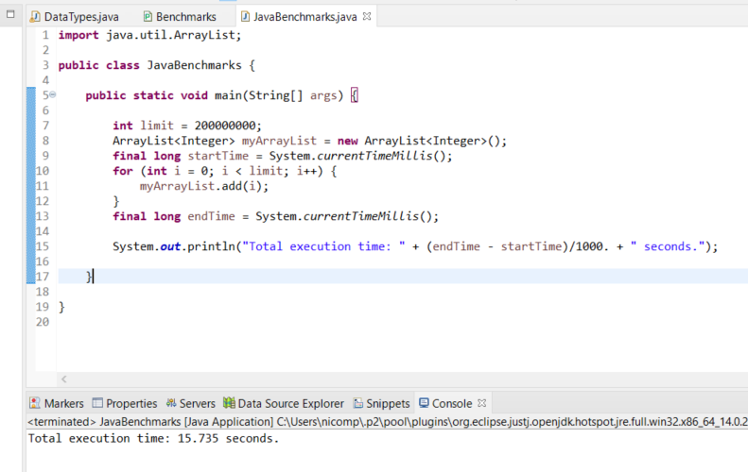
Benchmarks. Add 200,000,000 elements to a Python List, then a Java ArrayList.
--- 59.49281120300293 seconds ---
--- 38.224406003952026 seconds ---
Total execution time: 15.735 seconds.
Notes:
See .zip files in the repo: JavaBenchmark.zip, PythonBenchmark.zip

Slide 37
Questions?

Slide 38
References
[1] https://www.anaconda.com/
[2] https://www.python.org/
[3] https://www.java.com/
[4] https://www.eclipse.org/
A special thank you to Isaiah Dicristoforo, dicrisif@mail.uc.edu, for his invaluable contributions to the JupyterLab notebook files.

